Slide 1
Introductions
Omar Mallak
BSc Cyber Security and Digital Forensic
Security Awareness trainer in NCRC
Security Engineer in Green Circle
Notes:
My name is omar Mallak, I came from Jordan to get my bachelor’s degree in cyber security and digital forensics at the university of derby, I am in my final year at the moment working on my dissertation project which is creating a machine learning program that detects phishing email using their URL, I also used to play volleyball at the university team but I had to leave to concentrate more at my career, and if you are a coffee lover, I am also working as a service leader barista in Starbucks, I enjoy learning about different types of coffee and making them.

Slide 2
What will we cover today?
Introduction to cybersecurity: Why it’s difficult!
Why organisations get targeted
The Quick Wins! The importance of Security at home
Secure and unique passwords
Suspicious emails and what to do about them
Evaluating what you put online through social media
The importance of keeping devices up to date
Ransomware: Understanding a modern threat
How do we protect the organisation?
Questions and Answers – Security chat
Notes:
Okay what we will cover for our training session today, we will have an introduction to cyber security and what is cyber security, and we will talk about why people think cyber security is difficult and complicated, then we will talk about why organization gets targeted, we are going to talk about the importance of cyber security in your personal life and how to keep yourself secure, we will talk about how to create a unique password and keep it secure, then we will talk about how to deal with suspicious emails and what to do about them, after that we will talk about what you shouldn’t post in your social media and keep it for yourself, then we will have a talk in the importance of keeping your devices up to date.
Moreover, we are going to explain what is ransomware, how it affects you and how to secure ourselves from it, after that we will see how we could protect our organization from cyber attacks
Finally, if anyone has any questions I would be glad to answer them.

Slide 3
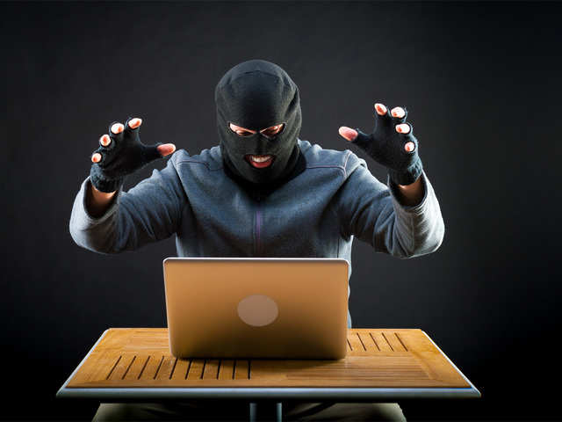
Intro to cybersecurity
What could a breach mean to a business?
TIME
REPUTATIONAL DAMAGE
COST
Notes:
Let’s say a successful cyber attack happened to a company, how will this affect the company, this will affect the company in three ways
Time
Cost
And the most important part is reputational damage
It could take a lot of time to recover from an attack,
The attack could cost the company a lot of money, stealing from the company and fines that could incur after the attack
Imagine yourself a client working with a large organization, and a successful cyber attack happened to this organization, you will not feel safe anymore to keep your data in that organization, or for example, if the attack happened to a bank, you will not feel safe anymore to use there online banking, or even to secure your many on that bank, so a cyber attack would cause large reputational damage which will cause losing clients which will cause losing large number of money

Slide 4
Intro to cybersecurity
Why is cybersecurity important?
Cybersecurity is NOT just the techy departments responsibility,
Because Cybersecurity is NOT just technical.
Today is about understanding security is a responsibility that belongs to everyone
So…

Slide 5
Security is EVERYONE’S responsibility

Slide 6
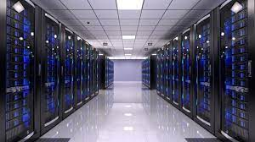
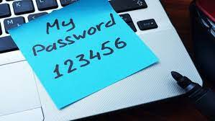
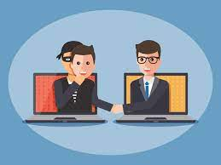
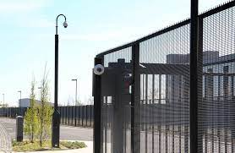
What is Cyber Security?
System vulnerability
Back Ups
Passwords
OSINT
Social Engineering
Physical security
Notes:
System vulnerabilities this is where there is a flaw or weakness within the system something that hasn't been picked up on the software is creation but could be actively used as an entry method for an attacker, it is like locking all your house doors but forgetting one window open
backups we need to think about taking backups of data if data does fall into the wrong hand or a virus deletes data we need to think about how we can get that information back safely and in a short time
Passwords are like the key to your car, you have the key you will be able to enter your car and drive anyway, if it is secure you will be the only one able to drive it, but if you put it beside your car anyone that sees it can drive it causing you losing your car (relate it to the social accounts)
OSINT: you probably wouldn't have heard this before but this is open source intelligence, what is open source intelligence essentially it's all the information that you freely give to the Internet that would allow a person to use that information to gather intelligence about yourselves
social engineering: using emotional factors to gain your trust financial grief excitement joy criminals will use all these emotions to attack you
physical security: although we talk about cyber security being computers we also need to think about the physical security surrounding them you wouldn't leave your laptop outside in a café because I won't come along I take it likewise if you have an area which is openly accessible to the public you need to think about what devices are being left should they be put into secure rooms for access is limited to a certain number of people

Slide 7
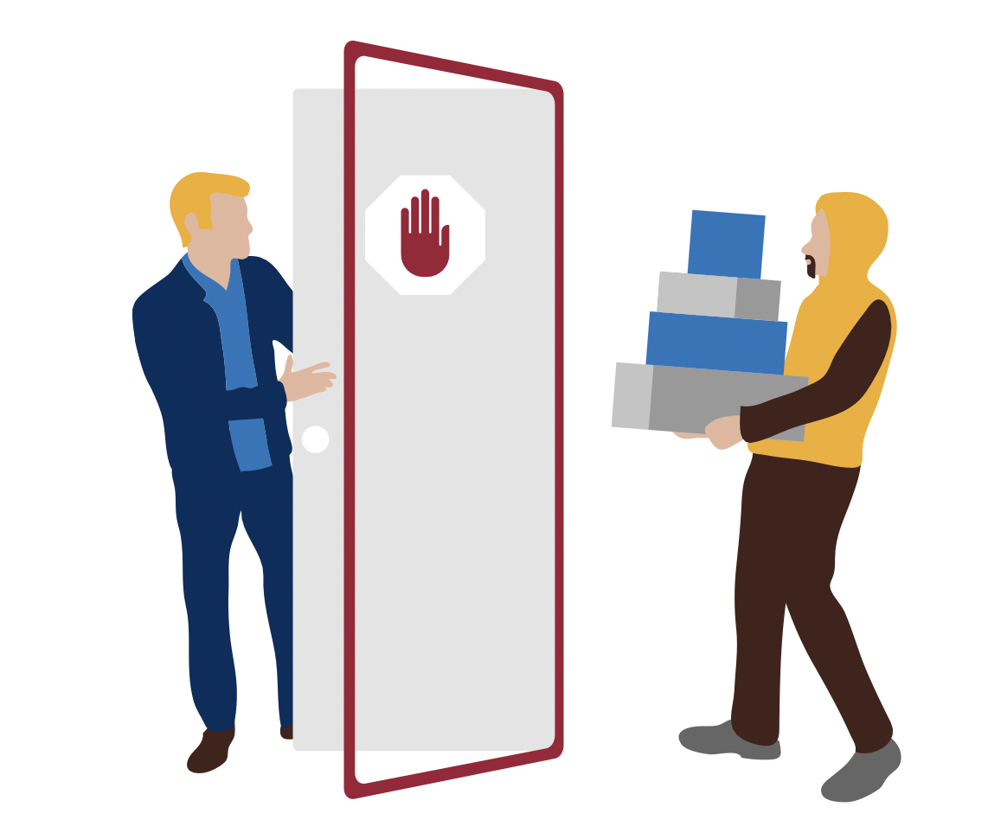
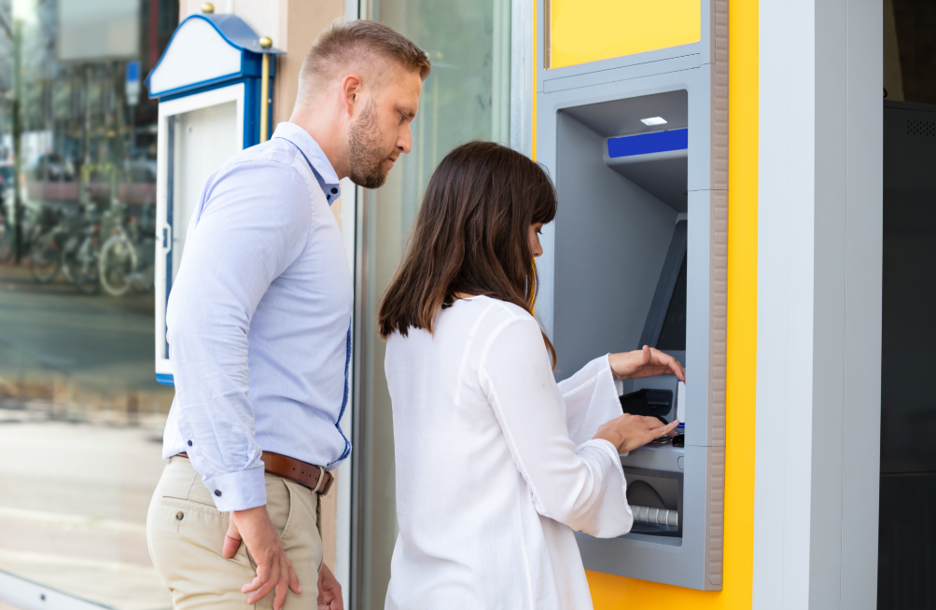
It’s not always technical…

Slide 8
https://www.youtube.com/watch?v=opRMrEfAIiI
Social Engineering
Notes:
JIMMY KIMMEL SHOW

Slide 9
Social Engineering
Social Engineering can be defined loosely as:
Exploiting the curiosity or kindness of others to achieve a hidden goal
Having a secure door held open for you
Littering USB sticks around an office in the hope that someone gets curious and plugs them in
Sneakily gathering information such as a first pets name during a casual conversation at the bus stop
Notes:
There are many ways to describe social engineering, it could be defined as Exploiting the curiosity or kindness of others to achieve a hidden goal
how many times have you walked into a building behind someone, and they've just opened the door for you and held it for you, this happens in secure facilities as well you may not know the person but out of super simple politeness you keep the door open for them
Littering USB sticks around an office/car park and people get curious they wonder what's on here could it be government secrets? no! it's more likely to be some malware that will infect your computer
Sneakily gathering information, as you have seen in the video before, within one minute they were able to let people give them their account passwords without them even noticing that they did it, we need to make sure we don’t give information that will help people guess our password, as an example the year you were born, many people use the year they were born in as their numeric pass

Slide 10
What you should know
Cybersecurity covers a vast area
What social engineering is
Different types of social engineering and how they work
Notes:
Okay so after that quick introduction, we should be getting to grips with a few things and feeling a bit more comfortable.
We should know that cyber is a huge field with so many different titles and roles – and we should know what we will be focusing on today
We’ve introduced the concept of social engineering and will build on that soon.

Slide 11
Importance of doing the small things/Quick wins at home
Secure and unique passwords
Notes:
So these are the quick wins! By the end of today, you should feel really comfortable with all of these topics and applying them in your life ,

Slide 12
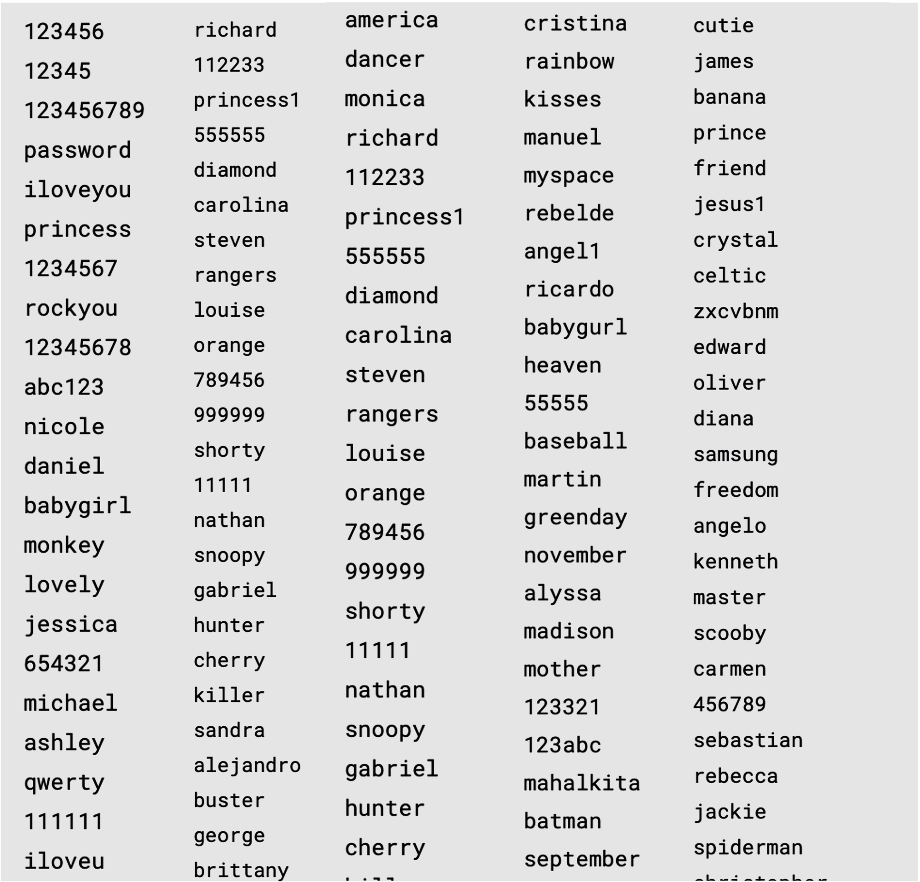
Secure and unique passwords – Password Lists
Examples of poor passwords:
password
dogsname1985
summer2022
child1child2!!
rockyou.txt
Old “Rockyou” list had 32,000,000 unique passwords
New “Rockyou” 2020 list?
8.4 Billion
Notes:
Password lists? What are these? It is a list of commonly used password within a text file that cyber criminals and professionals can use to break a password they will use your username and run a program to see if your password matches one of the common used ones, previously the rockyou list had 32 million common passwords on, the latest rockyou list now contains 8.4 billion common passwords that can be automatically matched to your account.

Slide 13
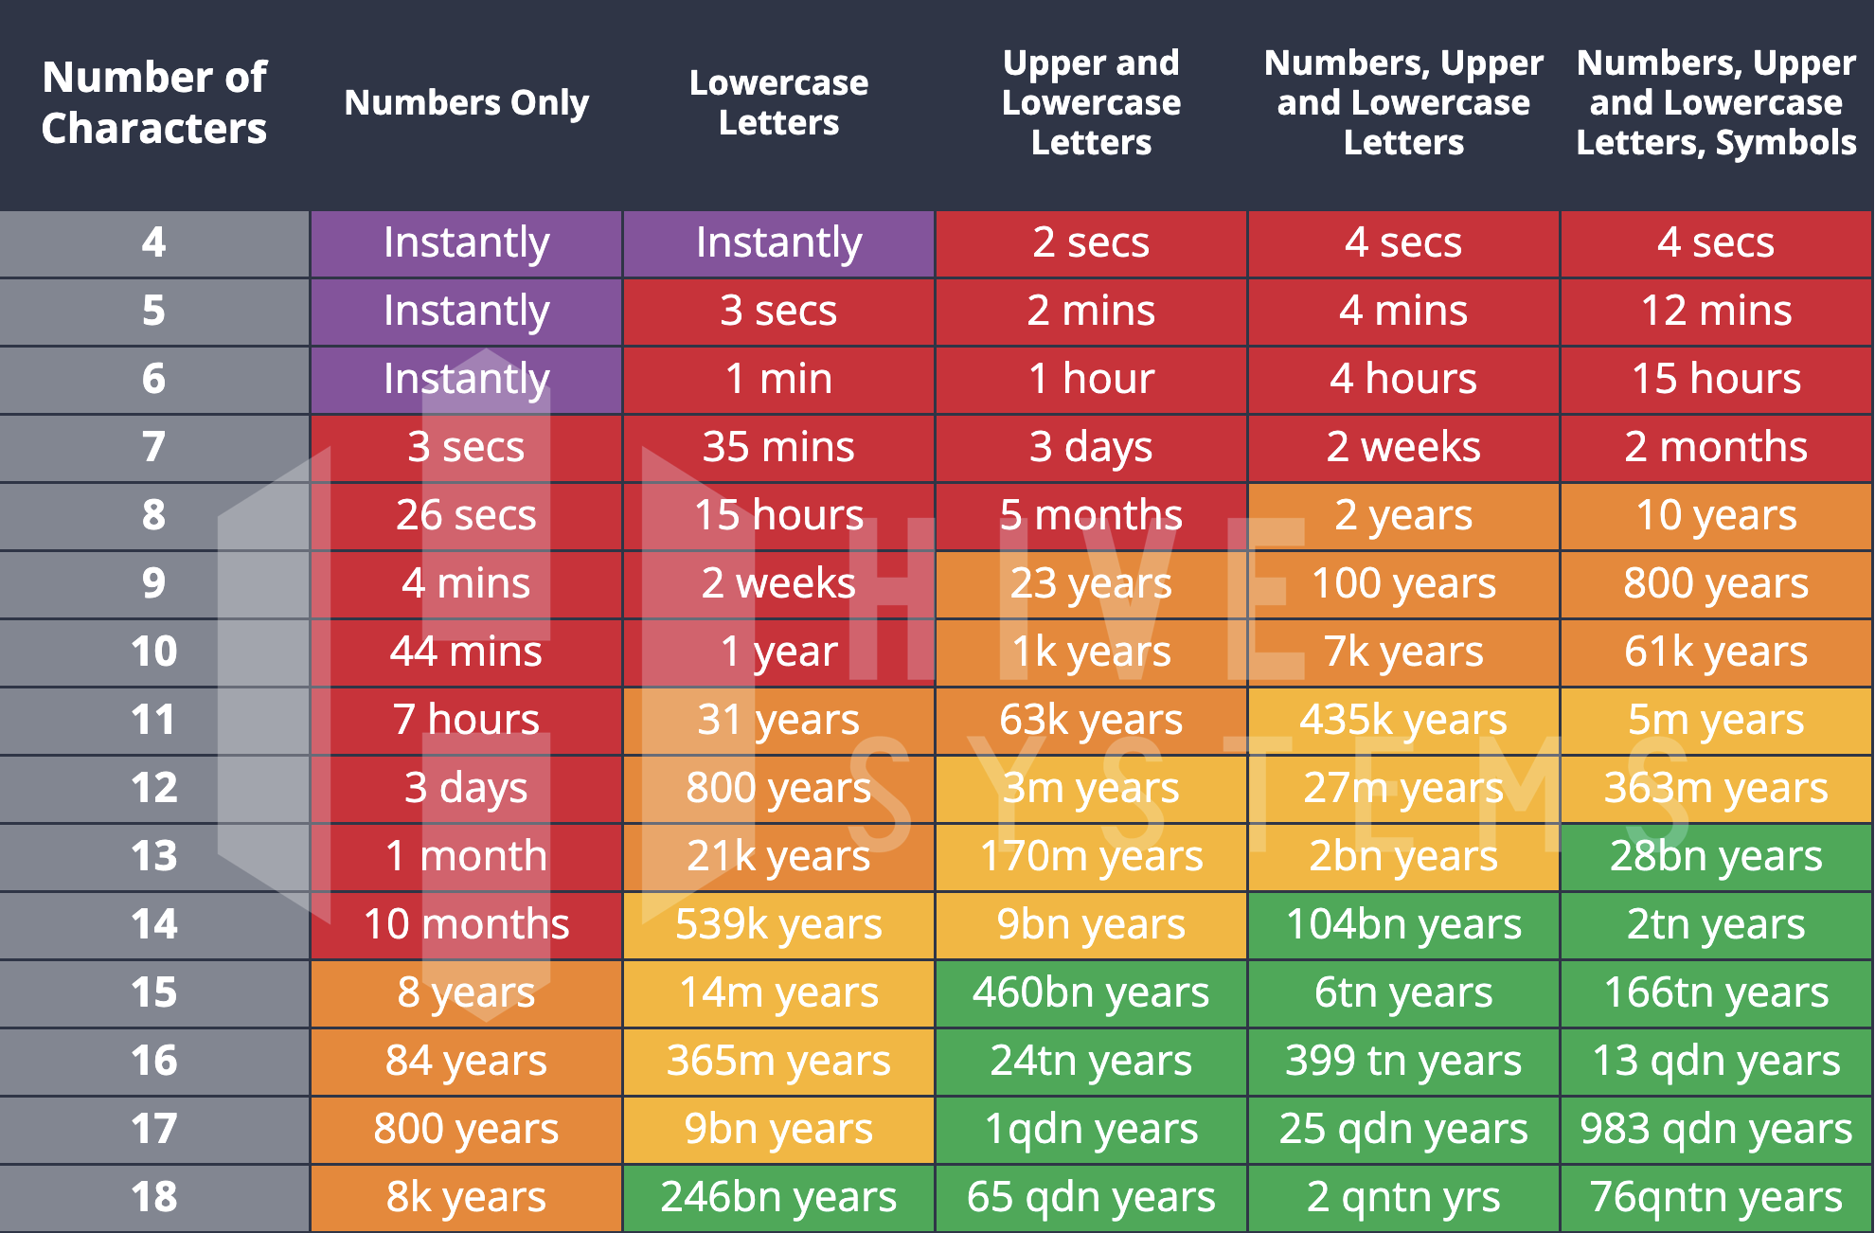
Secure and unique passwords – Brute force Password
Notes:
Ask in what color are they in and interact more
Make sure to show its okay to be on the red

Slide 14
Secure and unique passwords
Making a strong password
The NCSC recommends using 3 random words, with additional punctuation.
Humpty-Monitor-headphones
(25 upper/lower case and special symbol char)
Donkey%Apricot%Trumpet
(22 upper/lower case and special symbol char)
Weights&Golf&Beech
(18 upper/lower case and special symbol char)

Slide 15
Secure and unique passwords
PASSWORD MANAGERS
Allow you to have very long, very complex passwords…
(îogËAþpô|nú³«P}§Jl_pïi(äÅ<µ²ÏLSÌ\P±Éa¤~`ª¤,º¾úNQY+,Mº|"&¡=if>Ò'ÞâÒóg©ÒØKy,Jý¯y¸¡ÓÖã6®+e¿Ìèáºúßõ&=Ïï)
Notes:
Secure passwords are hard to memorize I think we can all agree to that especially seeing the password on the slide, I don’t think anyone will easily memorize that, so what is the solution? Use a password manager, okay but what is a password manager? A password manager will store all your passwords for you and make sure they are secure. Not only does it store all your unique passwords that are hard to remember but it also helps you identify legitimate websites, If any of you have used a password manager in the past you will see that when you go to a website you will automatically put in your information, it does this because it's recognised the website that you're viewing. cyber criminals are very good at creating a clone of a website an it's not hard, anyone can get a software on my computer where they can clone a website that could be anything from the NHSs website to a bank website, any small changes within the URL which is the address of the website such as www.hsbc.co.uk it will recognise if there is an error so say for example criminals using www.h5bc.co.uk you may not automatically pick that up when you're looking at it, human usually only read the first and the last letter other word when it goes into the brain so you may not pick up those small things but your password manager will and it will stop you from being scammed into putting your credentials into that website of some cybercriminals as well they will let you put in your you username they will then let you put in your password it will then continue to say error please try again but what happens then is it will redirect you to the legitimate site and it will make you re enter your details and you will log in you'll then think that you maybe you put an error in the password or username and it was your fault but what happened is they've stolen your login details and then forced you to put your details back in on the legitimate site without u having any idea to what happened

Slide 16
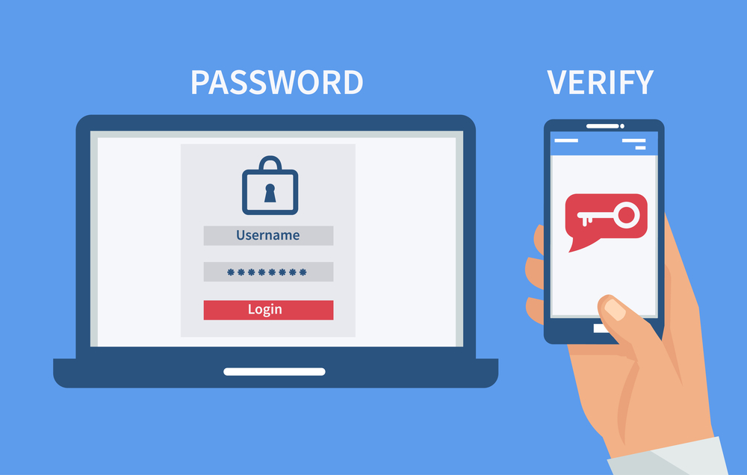
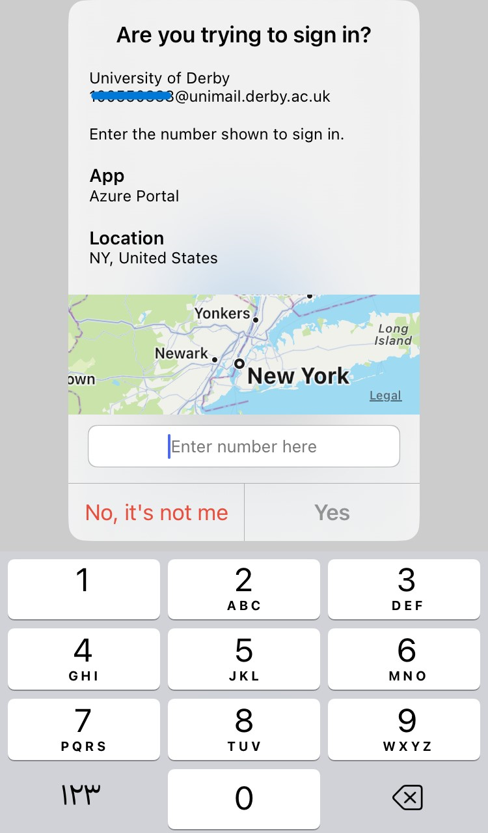
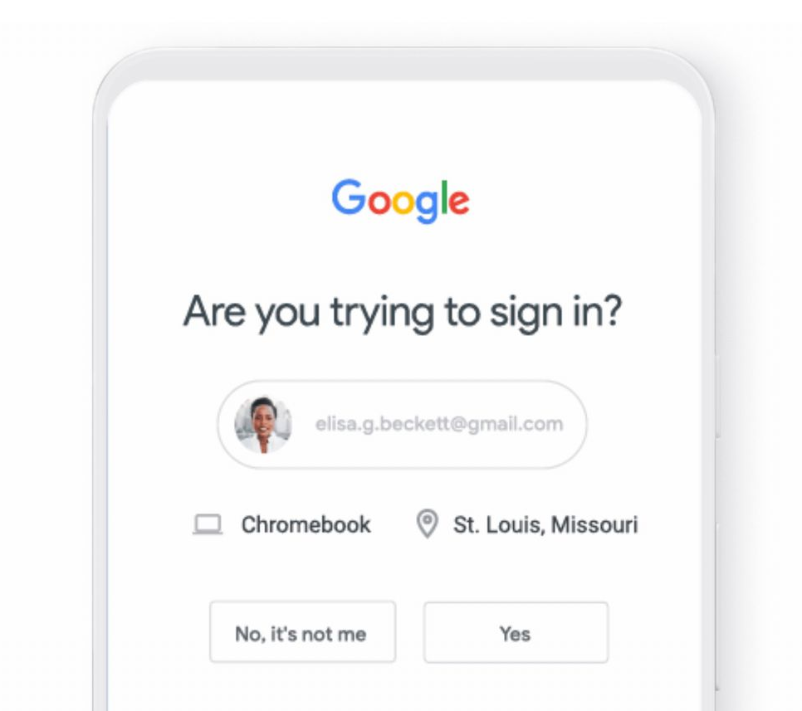
Secure and unique passwords
2FA – Two Factor Authentication
MFA – Multi Factor Authentication
Notes:
Two-factor authentication (2FA) is an identity and access management security method that requires two forms of identification to access resources and data. 2FA allows the user to monitor and help safeguard their most vulnerable information and networks.

Slide 17
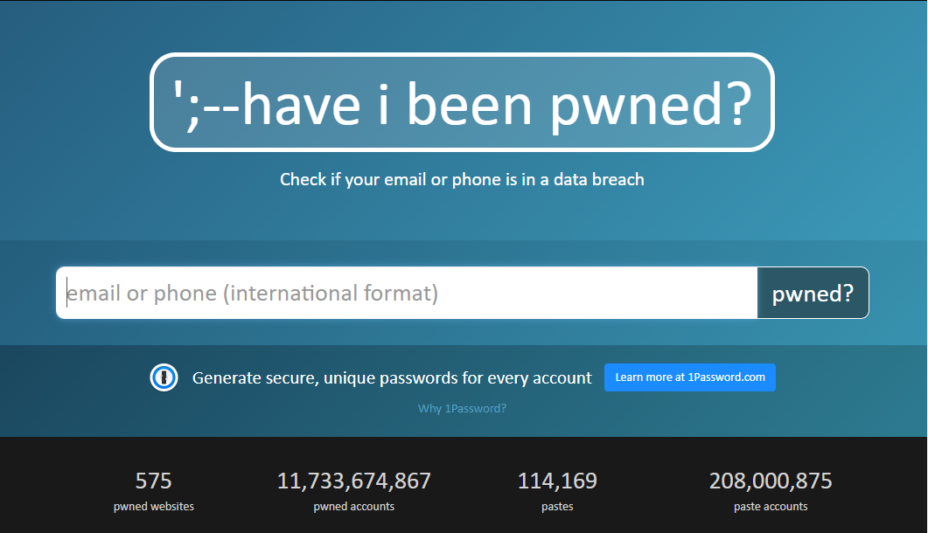
Secure and unique passwords
https://haveibeenpwned.com/
Go and have a check on the break…

Slide 18
What you should now know
The importance of having a strong password
What a strong password looks like
2FA and its protection
Password managers and their uses

Slide 19
Importance of doing the small things/Quick wins at home
Question emails that you are not expecting or feel out of place

Slide 20
Questioning emails – ‘ishing
Ever received an email or text you weren’t expecting?
What are you supposed to do when you get these messages?
We call any attack that uses social engineering across tech for profit or information an ‘ishing’ attack
Notes:
Lets go back to our unexpected email, has anyone else received one of these emails that he wasn’t expecting or didn’t make any sense.
Now what are u supposed to do are u supposed to ignore it? Or open it and check the link or what? We will talk about it in a minute
What do we call them? Will We call any attack that uses social engineering across tech for profit or information an ‘ishing’ attack
There is about 6 types of ishing attacks and we will go through them one by one in the next slide

Slide 21
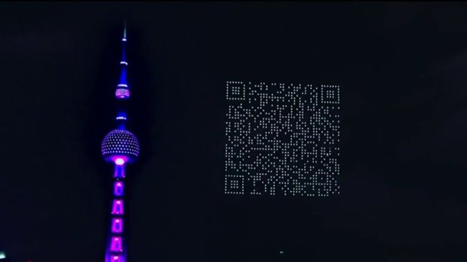
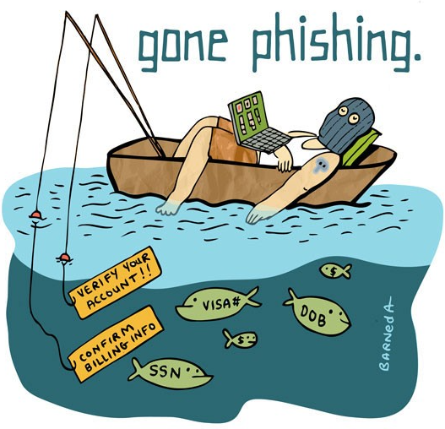
Questioning emails – ‘ishing
‘ishing is a social engineering attack
Different type of ‘ishing attack
Phishing
Whaling
Spear phishing
Vishing
Smishing
QRishing
Notes:
Phishing - is sending emails to users that look like a known brand, leverage social engineering tactics to create a heightened sense of immediacy and then lead people to click on a link or download an asset.
The links traditionally go to malicious websites that either steal credentials or install malicious code, known as malware, on a user’s device. The downloads, usually PDFs, have malicious content stored in them that installs the malware once the user opens the document.
Whaling - Malicious actors use social media or the corporate website to find the name of the organization’s CEO or another senior leadership member. They then impersonate that person using a similar email address. The email might ask for a money transfer or request that the recipient review a document
Spear phising - they target specific individuals within the organization using real names, job functions, or work telephone numbers to make the recipient think the email is from someone else inside the organization. Ultimately, because the recipient believes this is an internal request, the person takes the action mentioned in the email.
Vishing - Voice phishing, or “vishing,” happens when a cybercriminal calls a phone number and creates a heightened sense of urgency that makes a person take an action against their best interests. These calls normally occur around stressful times. Such as near the tax deadline
Smishing is sending texts that request a person take an action. These are the next evolution of vishing. Often, the text will include a link that, when clicked, installs malware on the user’s device.
QR ishing – using QR codes to direct people to fake sites or exploit devices

Slide 22
How to spot a phishing email
Is the email addressed to you by name or by vague reference (Valued customer, friend, colleague…)?
Design and quality might be poor – Think about what an email from this company should look like
Ishing can look like the real deal! They use company templates
Does the senders name and/or email address look legitimate?
Does it sound too good to be true?
Notes:
Check if the email was sent to you by name or it was an undefined reference
Check the design and the quality of the email, Imagine what an email from that company would look like
Ishing emails look like the real deal, sometimes they use the company templates
Check the sender name and email address if it does look legitimate
Is it too good to be true? If that is the case there is something suspicious then

Slide 23
How to spot a phishing email
The red flag checklist
Urgency (deadline)
Authority (email from someone is power)
Emotion – (make you panic or fearful)
Scarcity – (giving you something in short supply)
Curiosity (will try to entice you)
Current events (criminals use current events to lure you)
Bad speling/gramar
Notes:
What are the things you need to check when you read an email, that could detect a phishing email
Urgency, see if the email is urgent
Authority, is it sent from someone of power
Emotion, does the email make you stressful and make you panic?
Scarcity- giving you something in short supply
Curiosity – does it make you curios to open the link?
Current event
Does the email have bad spelling and grammar

Slide 24
How to spot a phishing email
Ask every time.
Were you expecting an email from this person?
Does this sound like the person you know?
Is this something this person would normally ask for?
If in doubt contact the person making the request via another means

Slide 25
Phishing Examples
Deduce if these are phishing emails!
View examples and in your mind identify if it is a phishing email or not
Think about what makes it a phishing email or not
Answers will be revealed
If you have questions, please let me know
@

Slide 26
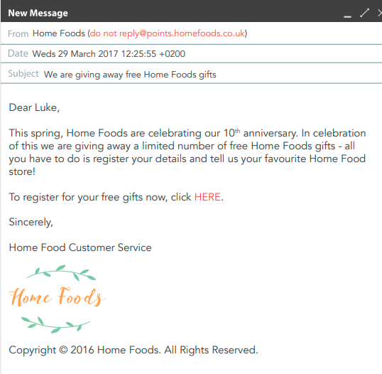
Phishing Example 1
REMEMBER:
Urgency
Authority
Emotion
Scarcity
Curiosity
Current events
Bad spelling/grammar

Slide 27
Phishing Example 1
REMEMBER:
Urgency
Authority
Emotion
Scarcity
Curiosity
Current events
Bad spelling/grammar

Slide 28
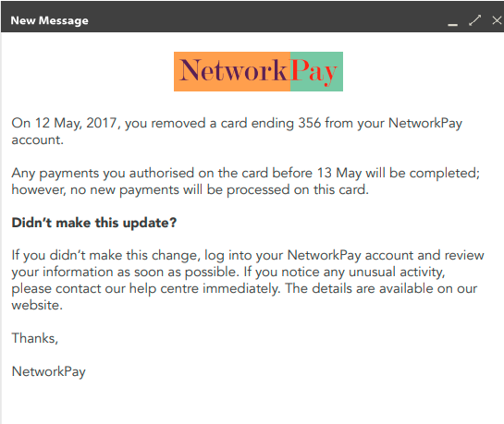
Phishing Example 2
REMEMBER:
Urgency
Authority
Emotion
Scarcity
Curiosity
Current events
Bad spelling/grammar

Slide 29
Phishing Example 2

Slide 30
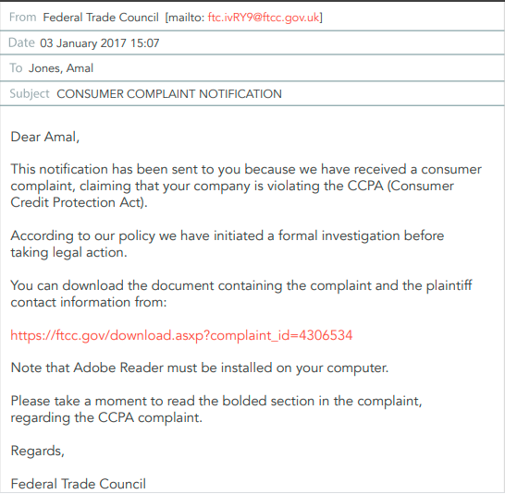
Phishing Example 3
REMEMBER:
Urgency
Authority
Emotion
Scarcity
Curiosity
Current events
Bad spelling/grammar

Slide 31
Phishing Example 3
REMEMBER:
Urgency
Authority
Emotion
Scarcity
Curiosity
Current events
Bad spelling/grammar

Slide 32
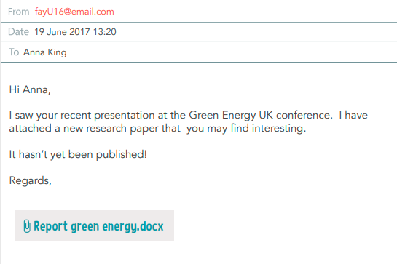
Phishing Example 4
REMEMBER:
Urgency
Authority
Emotion
Scarcity
Curiosity
Current events
Bad spelling/grammar

Slide 33
Phishing Example 4
REMEMBER:
Urgency
Authority
Emotion
Scarcity
Curiosity
Current events
Bad spelling/grammar

Slide 34
Falling victim to ‘ishing
(At Work)
If it happens to you…
Turn off your Wi-Fi/disconnect from the network (malware)
Know who to report the incident to
Change passwords
Notify credit agencies/financial institutes if banking details have been given
Don’t be embarrassed!

Slide 35
Falling victim to ‘ishing
(At Work)
In general,
Scan your computer for viruses
Well configured devices (disabling macros) and good defences can stop malware installing if a link is clicked
Up to date browsers will block known phishing and malware sites (not always the same case using a mobile phone)
Notes:
In general make sure you regularly scan your computer for malware devices, make sure u use well-configured devices and a good cyber security defence that will be able to stop you from installing the malware, and finally make sure your browser is always up to date so they are able to block phishing and malware

Slide 36
What you should now know
Understand the different types of ‘ishing attacks
Identify/spot phishing emails
What to do if you fall victim to one

Slide 37
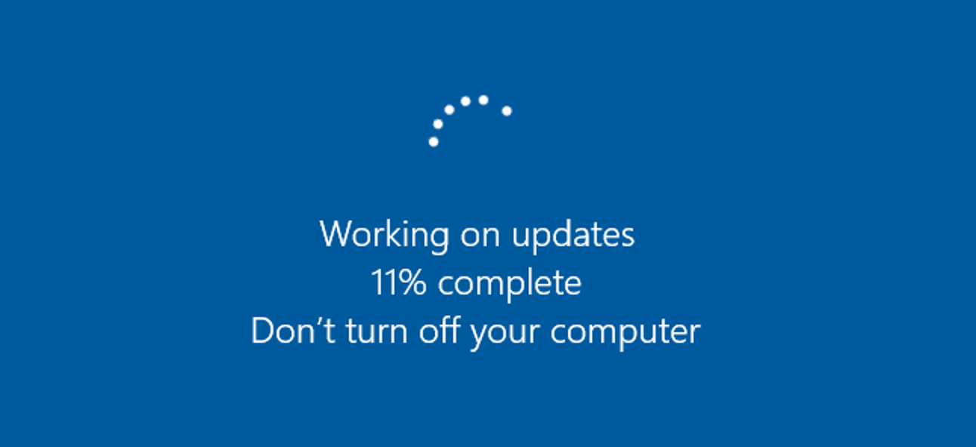
Keeping devices up to date
It’s so frustrating! But it’s for a reason.
Updates make sure that the technology that we love stays safe and up to date.
Notes:
Now, I know we all get this update at the worst time, especially when you are close to your deadline for submitting your work, I know we all hate, but this annoying thing here is your computer guard, and it updates itself to improve and fix its vulnerabilities to make sure your computer stay secure

Slide 38
Keeping devices up to date
Types of update…
Operating System
Application

Slide 39
What you should now know
Why we need to keep our devices up to date
Different aspects of our devices we need to keep up to date

Slide 40
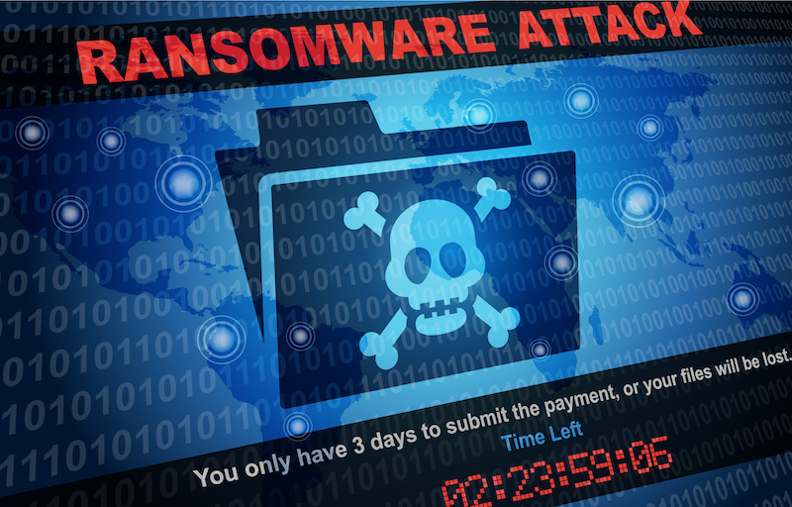
Ransomware
Have you heard of Ransomware?
A threat that encrypts all files on a device until a ransom is paid!
The cost can be incredibly high
The police recommend to never pay ransoms
Notes:
Ask the audience what is ransomware?
At a high level
Cost is high-businesses have closed after ransomware attacks
Don’t pay ransoms as it funds criminal activity and keeps the circle of life for a criminal going.

Slide 41
Ransomware – How it works
Ransomwares have different ways of working/infecting
In general –
When a link is clicked, the ransomware is activated/downloaded
Maps the network
Infects system and renders it unusable
Access to data not possible as it is encrypted
Ask for ransom
Advanced ransomware – Exfiltrates you data.
Notes:
So how does ransomware works, when a link is clicked it downloads or activates the ransomware which maps all your network and infects the system making it unusable
Where you will not be able to access your data again as it is encrypted, which will make the hacker to ask for a large number of moneys so they can give you the decrypt code and sometimes they don’t

Slide 42
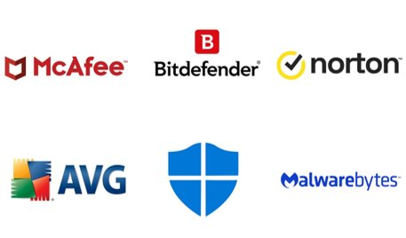
Ransomware - Protection
What can we do? A lot.
Keeping Operating Systems and apps up to date
Keeping Anti-Virus systems up to date
Do not click on random links/files you are not expecting or know what they are
Data should be backed up to a device/cloud that is not connected to your network to prevent the backup from being infected.
Data should be held in an encrypted form

Slide 43
What you should now know
What ransomware is
How it affects your system
The implications of getting ransomware on your system
Not just financial repercussions but also reputational damage
Protecting yourself from ransomware – Simple and easy.

