Slide 1

HTTP Protocol: The Language of the Web
A comprehensive overview of the Hypertext Transfer Protocol that powers every web interaction

Slide 2


The Foundation of the Web
What is HTTP?
HTTP stands for Hypertext Transfer Protocol - the fundamental communication protocol that enables web browsers and servers to exchange information seamlessly.
This client-server protocol fetches resources like HTML documents, images, and APIs, forming the backbone of modern web experiences.
HTTP is stateless - each request is independent and contains
no memory of previous interactions

Slide 3
HTTP Methods: The Verbs of Web Communication
HTTP methods define the action you want to perform on a server resource. Think of them as verbs that tell the server what you intend to do.
GET
POST
PUT
Retrieve data from the server without modifying anything. Safe and cacheable.
Submit new data to create resources. Used for form submissions and uploads.
Update or replace entire resources with new data. Idempotent operation.
DELETE
PATCH
Remove specified resources from the server permanently.
Partially modify existing resources without replacing them entirely.

Slide 4

HTTP Headers: Context for Every Conversation
Headers provide essential metadata that gives context to both requests and responses, enabling proper communication between clients and servers.
Request Headers
Response Headers
Host: Target server domain
Status: Request outcome
User-Agent: Client identification
Content-Type: Response body format
Accept: Content types preferred
Content-Length: Response size
Content-Type: Request body format
Set-Cookie: Session data
Authorization: Authentication credentials
Cache-Control: Caching instructions

Slide 5




Cookies: Giving HTTP a Memory
Since HTTP is stateless, cookies solve the challenge of remembering user information across multiple requests.
Session Management
Track user login status and maintain authenticated sessions across page visits and interactions.
Personalization
Store user preferences, language settings, and customization choices for tailored experiences.
Tracking & Analytics
Monitor user behavior patterns and gather insights for improving website performance and user experience.
Set-Cookie: sessionId=abc123; Path=/; Secure; HttpOnlyCookie: sessionId=abc123

Slide 6
HTTP Status Codes: The Server's Reply
Status codes communicate the outcome of your request in standardized three-digit numbers, grouped by response type.
2xx Success
3xx Redirection
200 OK - Request succeeded
301 Moved Permanently - Resource relocated
201 Created - New resource created
302 Found - Temporary redirect
204 No Content - Success, no response body
304 Not Modified - Use cached version
4xx Client Error
5xx Server Error
400 Bad Request - Invalid request syntax
500 Internal Server Error - Server malfunction
404 Not Found - Resource doesn't exist
503 Service Unavailable - Server overloaded
403 Forbidden - Access denied
502 Bad Gateway - Upstream server error

Slide 7
Anatomy of an HTTP Request
Every HTTP request follows a consistent three-part structure that provides all the information servers need to process your request.
01
02
03
Start-Line
Headers
Body
Contains the HTTP method, target resource path, and protocol version
Metadata providing context like host, content type, and authentication
Optional data payload (empty for GET requests, contains data for POST/PUT)
GET /api/users HTTP/1.1Host: www.example.comUser-Agent: Mozilla/5.0 (Chrome)Accept: application/json[Body often empty for GET requests]

Slide 8
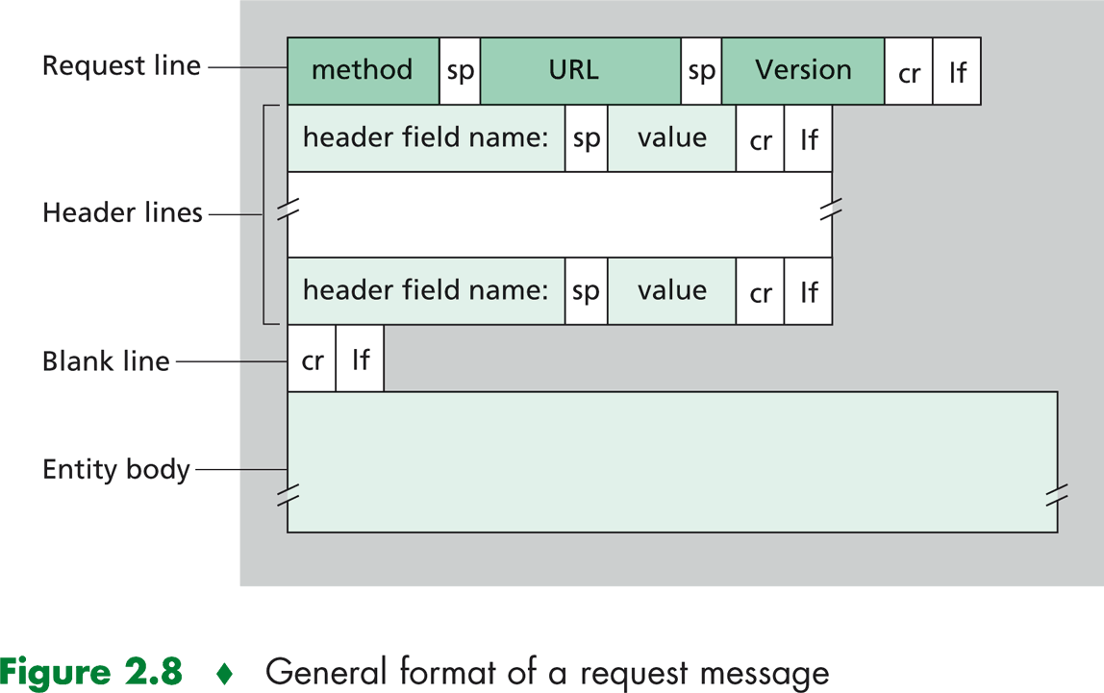

Slide 9




Anatomy of an HTTP Response
HTTP responses mirror the request structure, providing status information, metadata, and the requested content back to the client.
Status-Line
Protocol version, status code, and human-readable status phrase
Headers
Response metadata including content type, length, and caching directives
Body
The actual content requested - HTML, JSON, images, or other data types
HTTP/1.1 200 OKContent-Type: application/jsonContent-Length: 85Set-Cookie: sessionId=xyz789{ "users": [ {"id": 1, "name": "Alice"}, {"id": 2, "name": "Bob"} ]}

Slide 10
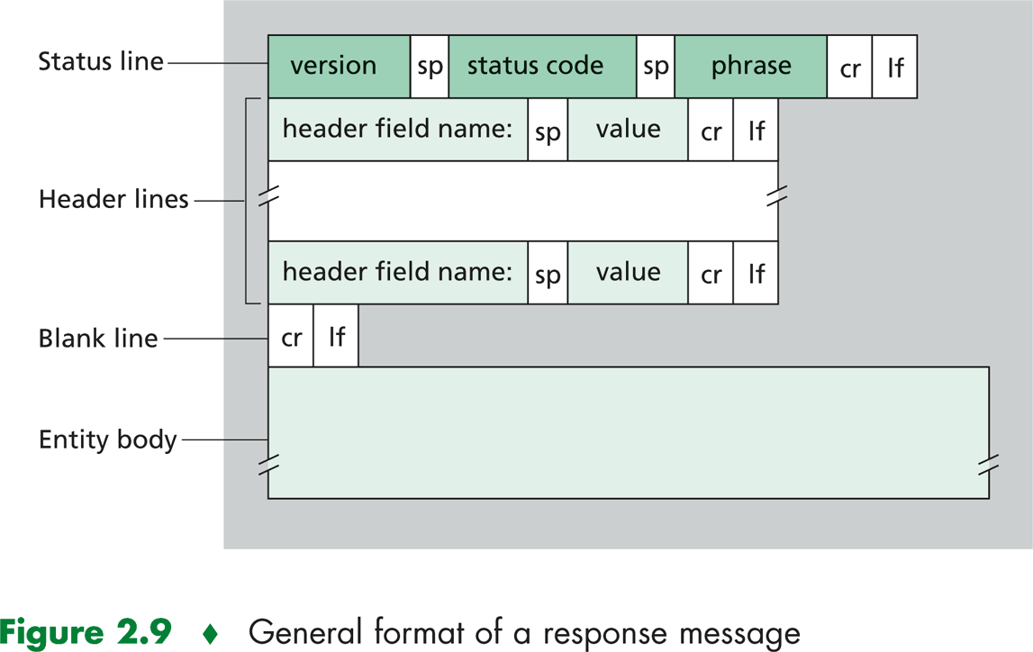

Slide 11






The Complete Request-Response Cycle
Understanding the full HTTP communication flow helps you debug issues and optimize web applications effectively.
Browser Request
Network Transport
Server Processing
Response Sent
Client Receives
1. Client Request
3. Server Response
Browser sends HTTP request with method, path, headers, and optional body
Server sends back status code, headers, and requested content to complete the cycle
1
2
3
2. Server Processing
Server receives, validates, and processes the request based on method and path

Slide 12







Key Takeaways
HTTP is the stateless client-server protocol that makes the modern web possible through standardized communication patterns.
Protocol Foundation
Request-Response Pattern
HTTP methods, headers, and status codes create a universal language for web communication
Every web interaction follows the same predictable cycle of request processing and response delivery
Developer Essential
Mastering HTTP fundamentals enables you to build, debug, and optimize web applications effectively
Questions?

