Slide 1
SOC Level 1 — Session 5

Slide 2
Agenda
• Introduction & Objectives
• Phishing: concepts, workflow, detections
• Brute Force: methods & defenses
• Malware: types, lifecycle, detection
• Insider threats: types, indicators
• Case study + Q&A + Homework

Slide 3
Phishing
Definition: Deceptive communication to trick users into revealing credentials or executing malware.
Common vectors: Email, SMS (smishing), Voice (vishing), social media.
Why it works: social engineering, urgency, spoofing.

Slide 4
Phishing — Detection & SOC Actions
• Detection sources:
• Email gateway
• Web proxy logs (malicious links)
• Endpoint detection (malicious attachments)
• SOC actions: validate headers, isolate attachments, block URLs, notify users.

Slide 5
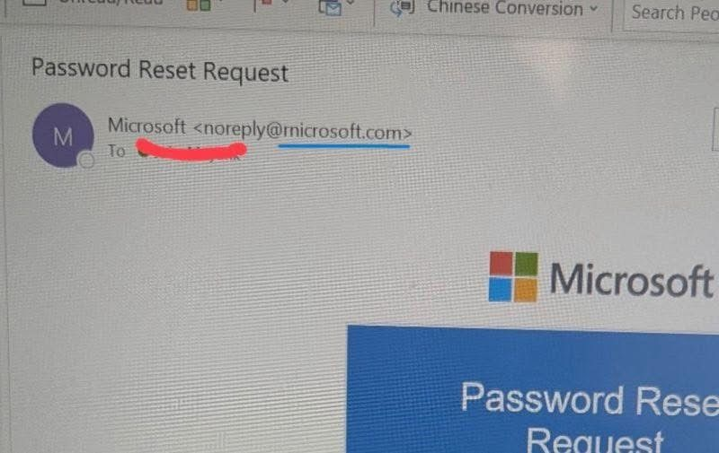
Phishing — Example Visual

Slide 6
Brute Force
Definition: Automated attempts to guess credentials or keys.
Common targets: SSH, RDP, web login forms, mail servers.
Techniques: credential stuffing, password spraying, dictionary attacks.

Slide 7
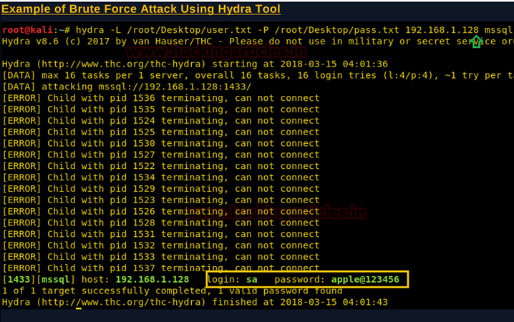
Brute Force — Example Visual

Slide 8
Brute Force — Detection & Mitigation
Detection sources:
Authentication logs (failed logins per account/IP)
Firewall / WAF logs (rate limit hits)
Mitigations: account lockouts, MFA, rate limiting, IP reputation blocking.
SOC playbook: correlate failed attempts, block offending IPs, force password reset for targeted accounts.

Slide 9
Malware
Definition: Software designed to perform malicious actions on a system.
Types: ransomware, trojans, wipers, droppers, botnets, backdoors.
Lifecycle: delivery → execution → persistence → C2 → actions on objective.

Slide 10
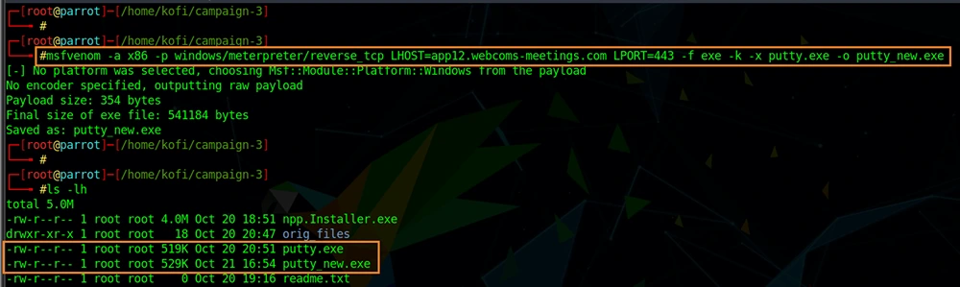
Malware — Example Visual

Slide 11
Malware — Detection & Response
Detection sources:
• Endpoint telemetry (process creation, suspicious binaries)
• Network telemetry (C2 beaconing, uncommon ports)
SOC actions: isolate host, capture memory image, collect IOCs, block C2, patch and remediate.

Slide 12
Insider Threats
Definition: Risk from authorized users who misuse access intentionally or accidentally.
Types: malicious insider, negligent insider, compromised insider.
Indicators: unusual data access, off-hours activity, large downloads to external storage.

Slide 13
Insider Threats — Detection & Controls
Detection sources:
DLP logs, file access logs, privileged access monitoring
Controls: least privilege, monitoring, separation of duties, behavior analytics.
SOC playbook: validate intent, check recent activity, escalate to HR/IR if malicious.

Slide 14
Case Study — Combined Attack Chain
Scenario: Phishing email delivers malware that establishes persistence; attacker uses stolen credentials to brute force other systems; suspicious insider aids exfiltration.
Discuss detection points, priority containment steps, and stakeholders to involve.

Slide 15
Homework (Technical)
Choose ONE of the following and submit screenshots + short report:
1) TryHackMe room: 'Phishing' or 'Intro to Malware Analysis'.
2) CyberDefenders challenge: reproduce a phishing-to-malware chain in a lab (screenshots of email, sandbox run, detection logs).
Deliverables: screenshots, one-paragraph summary.

Slide 16
Summary & Q&A

