Slide 1
Network Security Monitoring Essentials

Slide 2
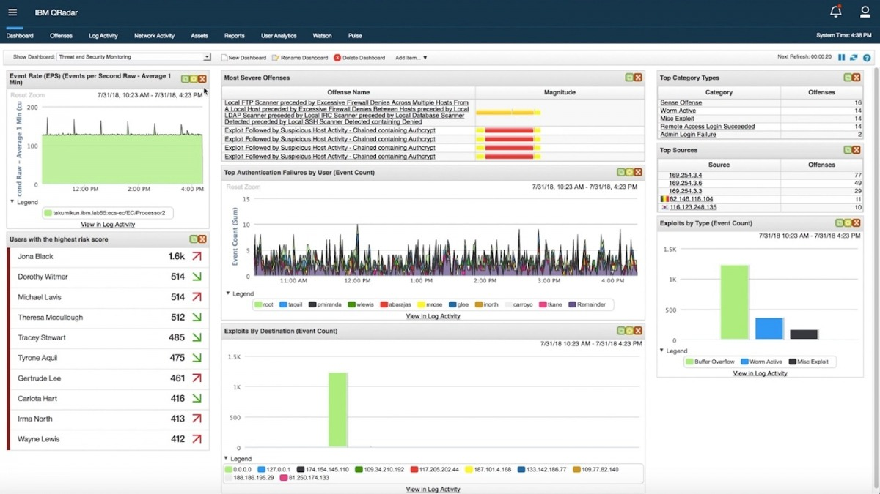

Slide 3
What is Network Security Monitoring?
🔍 Continuous collection, analysis, and escalation of network events
🛡️ Identifying malicious or abnormal behavior
📡 Focused on visibility, detection, and response

Slide 4
Why NSM Matters for SOC Analysts
Detects threats missed by endpoint tools
Identifies lateral movement & C2 traffic
Helps validate SIEM alerts across data sources
Improves overall threat visibility

Slide 5
Key Network Log Sources
🧱 Firewall logs
⚡ IDS/IPS alerts
🌐 Proxy logs
🔎 DNS logs
📊 NetFlow/sFlow/IPFIX
📁 Packet captures (PCAP)

Slide 6
Firewall Monitoring Essentials
Block/allow actions
Suspicious inbound/outbound traffic
Port scanning indicators
Policy violation attempts

Slide 7
IDS/IPS Monitoring
Signature-based detections
Behavioral alerts
Exploitation attempts
High-fidelity actionable threats

Slide 8
DNS Monitoring
Detect DNS tunneling
Suspicious domain lookups
Newly registered domain activity
Fast-flux patterns

Slide 9
Proxy & Web Traffic Monitoring
Unusual download behavior
Access to malicious URLs
Suspicious user-agents
TOR/VPN traffic detection

Slide 10
NetFlow Monitoring
📈 Flow-based visibility
🔁 Beaconing detection
🔗 Lateral movement tracing
🌐 DDoS pattern visibility

Slide 11
Common Attack Techniques Visible in Network Logs
Brute force attempts
Lateral movement (RDP, SMB)
Data exfiltration
Tunneling via DNS/ICMP

Slide 12
C2 (Command-and-Control) Indicators
Periodic beaconing
Connections to rare IPs
Encrypted abnormal traffic
DGA domain patterns

Slide 13
Beaconing Detection Basics
Regular timed connections
Low-volume persistent traffic
Same destination IP/domain
Consistent packet size

Slide 14
Anomaly Detection in Network Traffic
Baseline deviation monitoring
Unusual protocols
Abnormal data transfer
Internal-to-internal anomalies

Slide 15
SOC L1 Responsibilities
Reviewing alerts
Validating severity and impact
Correlating with endpoint/identity logs
Escalating confirmed threats

Slide 16
Common NSM Tools
🧪 Zeek
🛡️ Suricata
🐍 Snort
🧰 Wireshark
📊 NetFlow tools
🔭 SIEM platforms

Slide 17
Summary
NSM is critical for visibility
DNS, NetFlow, proxy, firewall logs matter
SOC L1 must detect anomalies early

